Slide 1
S-LoRA - Empowering Multiple LoRA-Adapted Models

Slide 2
WHAT IS LORA .
Low-Rank Adaptation (LoRA) is a technique that accelerates the fine-tuning of large models while consuming less memory. To make fine-tuning more efficient, LoRA’s approach is to represent the weight updates with two smaller matrices (called update matrices) through low-rank decomposition.
Low-Rank Adaptation (LoRA), a parameter-efficient fine-tuning method, is often employed to adapt a base model to a multitude of tasks, resulting in a substantial collection of LoRA adapters derived from one base model.
LoRA makes fine-tuning more efficient by drastically reducing the number of trainable parameters.
The original pre-trained weights are kept frozen, which means you can have multiple lightweight.
LoRA does not add any inference latency because adapter weights can be merged with the base model.

Slide 3
S-lora
S-LoRA, a system designed to handle many of these LoRA-adapted models efficiently.
"Pretrain-then-finetune" Paradigm: This is a common approach for using large language models.
S-LoRA, a system designed for the scalable serving of many LoRA adapters.
S-LoRA stores all adapters in the main memory and fetches the adapters used by the currently running queries to the GPU memory.

Slide 4
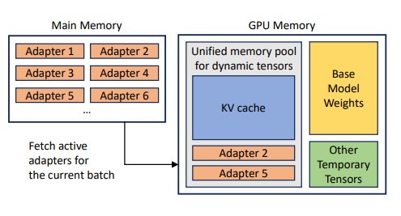

Slide 5
Unified paging And Optimization techniques
To efficiently use the GPU memory and reduce fragmentation.
Unified Paging uses a unified memory pool to manage dynamic adapter weights with different ranks and KV cache tensors with varying sequence lengths.
To reduce memory fragmentation and increase batch size, S-LoRA introduces a unified memory pool. This pool manages dynamic adapter weights and KV cache tensors by a unified paging mechanism.

Slide 6
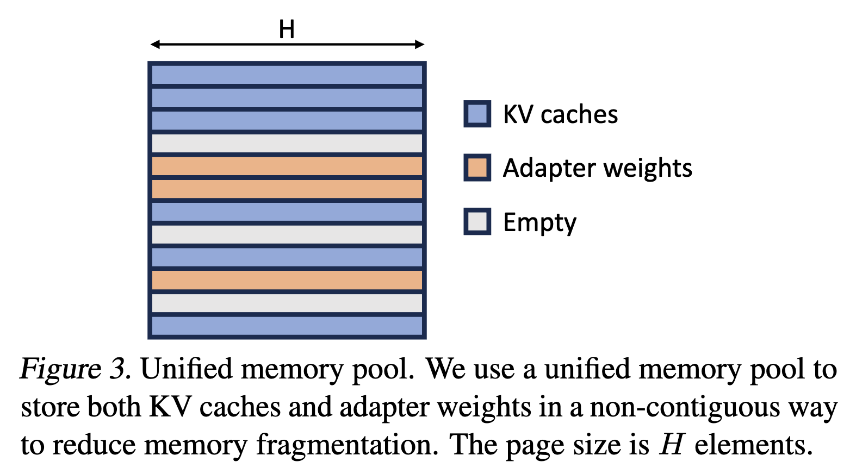

Slide 7
Heterogeneous Batching:
To minimize the latency overhead when batching different adapters of varying ranks, S-LoRA employs highly optimized custom CUDA kernels.
These kernels operate directly on non-contiguous memory and align with the memory pool design, facilitating efficient batched inference for added LoRA computation.
S-LoRA employs a novel tensor parallelism strategy and highly optimized custom CUDA kernels for heterogeneous batching of LoRA computation.

Slide 8
tensor parallelism
S-LoRA TP: To ensure effective parallelization across multiple GPUs, S-LoRA introduces a novel tensor parallelism strategy.
This approach incurs minimal communication cost for the added LoRA computation compared to that of the base model.
This is realized by scheduling communications on small intermediate tensors and fusing them with the communications of the base model.
Memory fragmantation : When we have lot of unused spaces in memory block. This is in efficient.

Slide 9
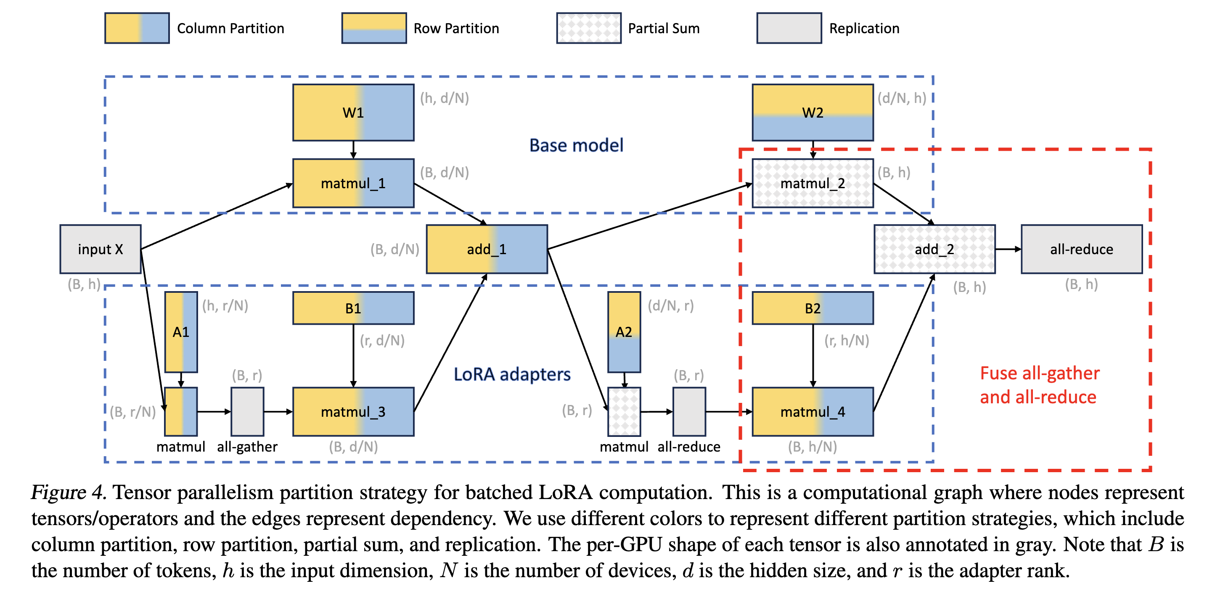

Slide 10
Performance Gains
these features enable S-LoRA to serve thousands of LoRA adapters on a single GPU.
Compared to state-of-the-art libraries such as Hugging Face PEFT and vLLM (with naive support of LoRA serving).
S-LoRA can improve the throughput by up to 4 times and increase the number of served adapters by several orders of magnitude.
S-LoRA enables scalable serving of many task-specific fine-tuned models and offers the potential for large-scale customized fine-tuning services.

